Slide 1
Concurrent Programming (Thread-based)
Prof. Joonwon Lee(joonwon@skku.edu)
TA – Taekyun Roh(throh0198@gmail.com)
Sewan Ha(hsewan2495@gmail.com)
Sungkyunkwan University
http://csl.skku.edu

Slide 2
Echo Server Revisited
int main (int argc, char *argv[]) {
...
listenfd = socket(AF_INET, SOCK_STREAM, 0);
bzero((char *)&saddr, sizeof(saddr));
saddr.sin_family = AF_INET;
saddr.sin_addr.s_addr = htonl(INADDR_ANY);
saddr.sin_port = htons(port);
bind(listenfd, (struct sockaddr *)&saddr, sizeof(saddr));
listen(listenfd, 5);
while (1) {
connfd = accept(listenfd, (struct sockaddr *)&caddr, &clen);
while ((n = read(connfd, buf, MAXLINE)) > 0) {
printf ("got %d bytes from client.\n", n);
write(connfd, buf, n);
}
close(connfd);
}
}

Slide 3
Iterative Servers (1)
One request at a time
client 1
server
client 2
call connect
call accept
call connect
ret connect
call read
ret accept
write
ret read
close
close
call accept
ret connect
ret accept
call read
write
ret read
close
close

Slide 4
Iterative Servers (2)
Fundamental flaw
Solution: use concurrent servers instead
Use multiple concurrent flows to serve multiple clients at the same time.
client 1
server
client 2
call accept
call connect
ret connect
ret accept
call fgets
Server blocks
waiting for
data from
Client 1
call read
call connect
User goes
out to lunch
Client 1 blocks
waiting for user
to type in data
Client 2 blocks
waiting to complete
its connection
request until after
lunch!

Slide 5
Process-based Servers
client 1
server
client 2
call accept
call connect
call connect
ret connect
ret accept
child 1
fork
call read
call accept
ret connect
Call read
ret accept
call fgets
write
fork
child 2
write
end read
call
read
call read
...
write
close
end read
close

Slide 6


Thread-based Servers
client 1
thread 1
server
thread 2
client 2
call accept
call connect
call connect
ret connect
ret accept
$$fd_{1}$$
call read
call accept
ret connect
Call read
ret accept
call fgets
write
write
end read
$$fd_{2}$$
call
read
call read
...
write
close
end read
close

Slide 7
Concurrent Programming Thread-based

Slide 8
Traditional View
Process = process context + address space
Process context
Code, data, and stack
Program context:
Data registers
Condition codes
Stack pointer (SP)
Program counter (PC)
Kernel context:
VM structures
Descriptor table
brk pointer
SP
stack
shared libraries
brk
run-time heap
read/write data
PC
read-only code/data
0

Slide 9
Alternate View
Process = thread context + kernel context + address space
Thread (main thread)
Code and Data
shared libraries
SP
stack
brk
run-time heap
Thread context:
Data registers
Condition codes
Stack pointer (SP)
Program counter (PC)
read/write data
PC
read-only code/data
0
Kernel context:
VM structures
Descriptor table
brk pointer

Slide 10
A Process with Multiple Threads
Multiple threads can be associated with a process.
Each thread has its own logical control flow (sequence of PC values)
Each thread shares the same code, data, and kernel context
Each thread has its own thread id (TID)
Thread 1 (main thread)
Shared code and data
Thread 2 (peer thread)
shared libraries
stack 1
stack 2
run-time heap
Thread 1 context:
Data registers
Condition codes
SP1
PC1
read/write data
Thread 2 context:
Data registers
Condition codes
SP2
PC2
read-only code/data
0
Kernel context:
VM structures
Descriptor table
brk pointer

Slide 11
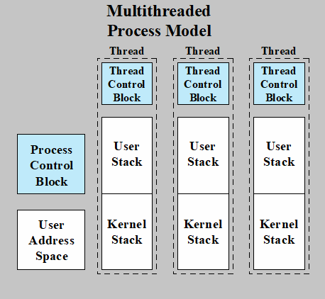
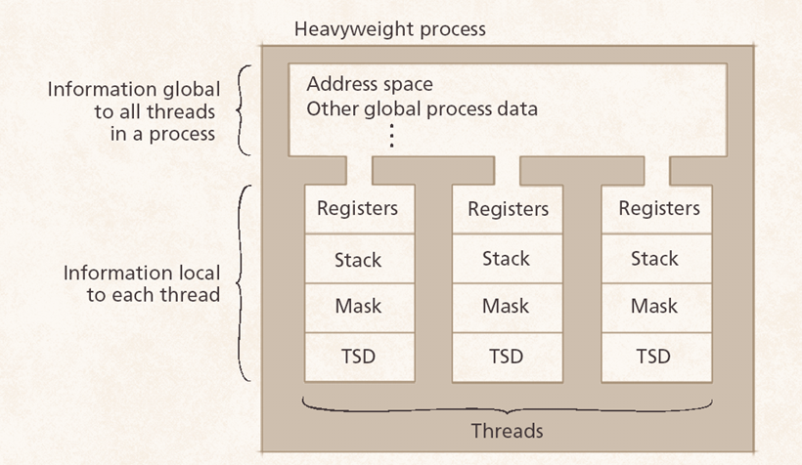
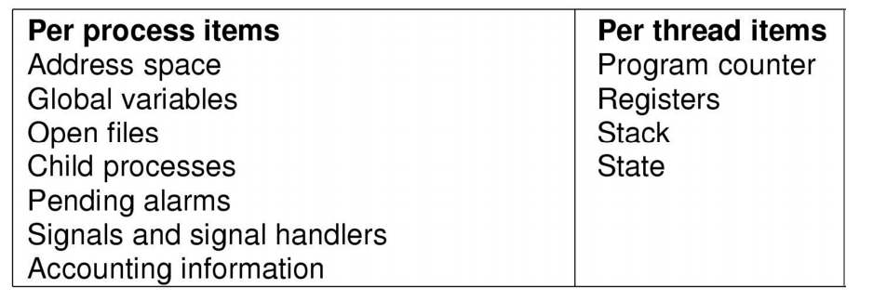
A Process with Multiple Threads
Multithreaded Process Model

Slide 12
Logical View of Threads
Threads associated with a process form a pool of peers
Unlike processes which form a tree hierarchy
Threads associated with process foo
Process hierarchy
T2
P0
T4
T1
P1
shared code, data
and kernel context
sh
sh
sh
T5
T3
foo

Slide 13
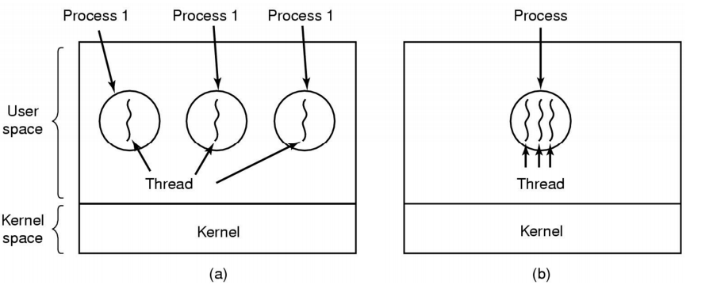
Threads vs. Processes
Logical view of processes vs threads

Slide 14
Threads vs. Processes
How threads and processes are similar
Each has its own logical control flow.
Each can run concurrently.
Each is context switched.
How threads and processes are different
Threads share code and data, processes (typically) do not.
Threads are somewhat less expensive than processes.
Linux 2.4 Kernel, 512MB RAM, 2 CPUs
-> 1,811 forks()/second
-> 227,611 threads/second (125x faster)

Slide 15
Pthreads Interface
POSIX Threads Interface
Creating and reaping threads
pthread_create()
pthread_join()
Determining your thread ID
pthread_self()
Terminating threads
pthread_cancel()
pthread_exit()
exit (terminates all threads), return (terminates current thread)
Synchronizing access to shared variables
pthread_mutex_init()
pthread_mutex_[un]lock()
pthread_cond_init()
pthread_cond_[timed]wait()
pthread_cond_signal(), etc.

Slide 16
“hello, world” Program (1)
/*
* hello.c - Pthreads "hello, world" program
*/
#include "pthread.h"
void *thread(void *vargp);
int main() {
pthread_t tid;
pthread_create(&tid, NULL, thread, NULL);
pthread_join(tid, NULL);
exit(0);
}
/* thread routine */
void *thread(void *vargp) {
printf("Hello, world!\n");
return NULL;
}
Thread attributes
(usually NULL)
Thread arguments
(void *p)
return value
(void **p)

Slide 17
“hello, world” Program (2)
Execution of threaded “hello, world”
main thread
call pthread_create()
pthread_create() returns
peer thread
call Pthread_join()
printf()
main thread waits for
peer thread to terminate
return NULL;
(peer thread
terminates)
pthread_join() returns
exit()
terminates
main thread and
any peer threads

Slide 18
Echo Server: Thread-based
int main (int argc, char *argv[])
{
int *connfdp;
pthread_t tid;
. . .
while (1) {
connfdp = (int *)
malloc(sizeof(int));
*connfdp = accept (listenfd,
(struct sockaddr *)&caddr,
&caddrlen));
pthread_create(&tid, NULL,
thread_main, connfdp);
}
}
void *thread_main(void *arg)
{
int n;
char buf[MAXLINE];
int connfd = *((int *)arg);
pthread_detach(pthread_self());
free(arg);
while((n = read(connfd, buf,
MAXLINE)) > 0)
write(connfd, buf, n);
close(connfd);
return NULL;
}

Slide 19
Implementation Issues (1)
Must run “detached” to avoid memory leak.
At any point in time, a thread is either joinable or detached.
Joinable thread can be reaped and killed by other threads
Must be reaped (with pthread_join()) to free memory resources.
Detached thread cannot be reaped or killed by other threads.
Resources are automatically reaped on termination.
Exit state and return value are not saved.
Default state is joinable.
Use pthread_detach(pthread_self()) to make detached.

Slide 20
Implementation Issues (2)
Must be careful to avoid unintended sharing
For example, what happens if we pass the address connfd to the thread routine?
All functions called by a thread must be thread-safe.
A function is said to be thread-safe or reentrant, when the function may be called by more than one thread at a time without requiring any other action on the caller’s part.
int connfd;
. . .
pthread_create(&tid, NULL, thread_main, &connfd);
. . .

Slide 21
Thread-based Designs
Pros
Easy to share data structures between threads.
e.g., logging information, file cache, etc.
Threads are more efficient than processes.
Cons
Unintentional sharing can introduce subtle and hard-to-reproduce errors!
The ease with which data can be shared is both the greatest strength and the greatest weakness of threads.

Slide 22
Concurrent Programming Examples

Slide 23
Example1
Complete producer/consumer problem
Code is uploaded on i-campus
Fill in the blanks to operate correctly.

Slide 24
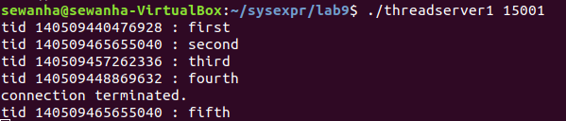
Example2
Make thread-based concurrent server
Create concurrent server with fixed number of thread
All file descriptors will be stored in buffer
Each thread is created at first and get file descriptors from buffer to communicate client.
Suppose the number of threads is 4
Example

